Slide 1

Learning jQuery Chapter 2: Selecting Elements

Slide 2
Introduction
The jQuery library harnesses the power of Cascading Style Sheets (CSS) selectors to let us quickly and easily access elements or groups of elements in Document Object Model (DOM).
In this chapter, we will cover:
The structure of the elements on a web page
How to use CSS selectors to find elements on the page
Custom jQuery extensions to the standard set of CSS selectors
The DOM traversal methods, which provide greater flexibility for accessing elements on the page

Slide 3
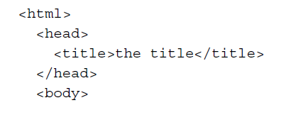
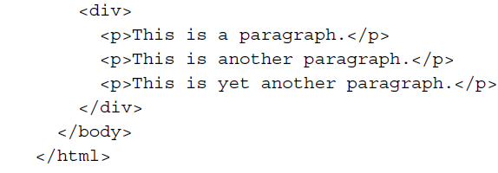
Understanding the DOM
One of the most powerful aspects of jQuery is its ability to make selecting elements in the DOM easy. The DOM serves as the interface between JavaScript and a web page; it provides a representation of the source HTML as a network of objects rather than as plain text.
This network takes the form of a family tree of elements on the page. When we refer to the relationships that elements have with one another, we use the same terminology that we use when referring to family relationships: parents, children, and so on. A simple example can help us understand how the family tree metaphor applies to a document:

Slide 4
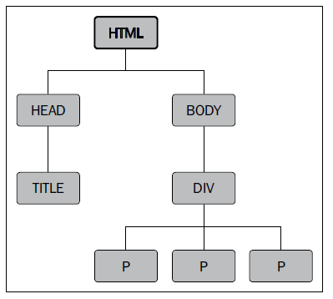
Understanding the DOM
Here, <html> is the ancestor of all the other elements; in other words, all the other elements are descendants of <html>. The <head> and <body> elements are not only descendants, but children of <html> as well. Likewise, in addition to being the ancestor of <head> and <body>, <html> is also their parent. The <p> elements are children (and descendants) of <div>, descendants of <body> and <html>, and siblings of each other.
To help visualize the family tree structure of the DOM, we can use a number of software tools, such as the Firebug plugin for Firefox or the Web Inspector in Safari or Chrome.
With this tree of elements at our disposal, we'll be able to use jQuery to efficiently locate any set of elements on the page. Our tools to achieve this are jQuery selectors and traversal methods.

Slide 5
Using the $() function
The resulting set of elements from jQuery's selectors and methods is always represented by a jQuery object. Such a jQuery object is very easy to work with when we want to actually do something with the things that we find on a page.
We can easily bind events to these objects and add slick effects to them, as well as chain multiple modifications or effects together.
In order to create a new jQuery object, we use the $() function. This function typically accepts a CSS selector as its sole parameter and serves as a factory returning a new jQuery object pointing to the corresponding elements on the page. Just about anything that can be used in a stylesheet can also be passed as a string to this function, allowing us to apply jQuery methods to the matched set of elements.

Slide 6
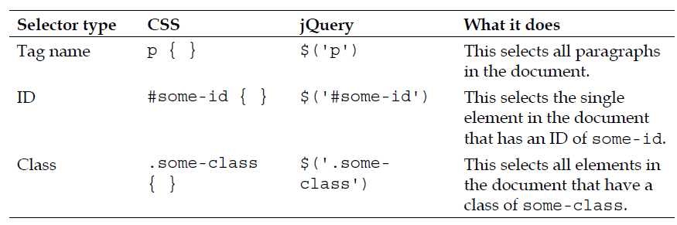
Using the $() function
The three primary building blocks of selectors are tag name, ID, and class. They can be used either on their own or in combination with others. The following simple examples illustrate how these three selectors appear in code:

Slide 7
Using the $() function
As mentioned in Chapter 1, Getting Started, when we call methods of a jQuery object, the elements referred by the selector we passed to $() are looped through automatically and implicitly. Therefore, we can usually avoid explicit iteration, such as a for loop, that is so often required in DOM scripting.
Now that we have covered the basics, we're ready to start exploring some more powerful uses of selectors.

Slide 8
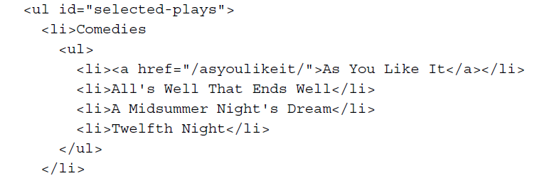
CSS selectors
The jQuery library supports nearly all the selectors included in CSS specifications 1 through 3, as outlined on the World Wide Web Consortium's site: http://www.w3.org/Style/CSS/specs. This support allows developers to enhance their websites without worrying about which browsers might not understand more advanced selectors, as long as the browsers have JavaScript enabled.
To begin learning how jQuery works with CSS selectors, we'll use a structure that appears on many websites, often for navigation – the nested unordered list:
Continues →

Slide 9
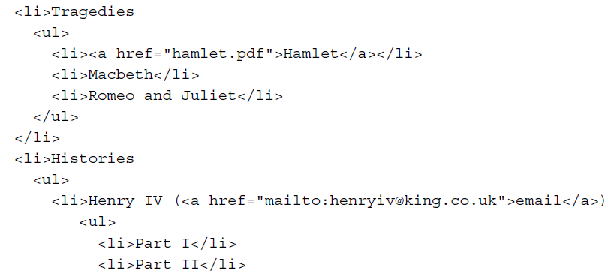
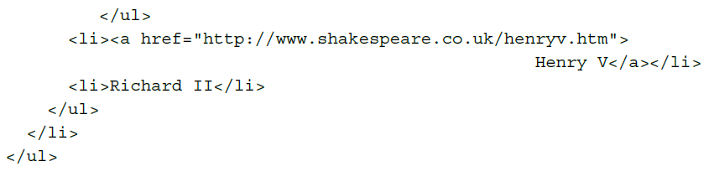
CSS selectors

Slide 10
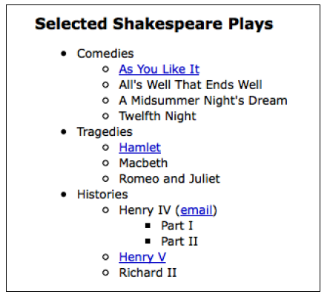
CSS selectors
Notice that the first <ul> has an ID of selecting-plays, but none of the <li> tags have a class associated with them. Without any styles applied, the list looks like this:
The nested list appears as we would expect it to—a set of bulleted items arranged vertically and indented according to their level.

Slide 11
Styling list-item levels
Let's suppose that we want the top-level items, and only the top-level items—Comedies, Tragedies, and Histories—to be arranged horizontally. We can start by defining a horizontal class in the stylesheet:
.horizontal {
float: left;
list-style: none;
margin: 10px;
}
The horizontal class floats the element to the left-hand side of the one following it, removes the bullet from it if it's a list item, and adds a 10-pixel
margin on all sides of it.
Rather than attaching the horizontal class directly in our HTML, we’ll add it dynamically to the top-level list items only, to demonstrate jQuery's
use of selectors:
$(document).ready(function() {
$('#selected-plays > li').addClass('horizontal');
});
Listing 2.1

Slide 12
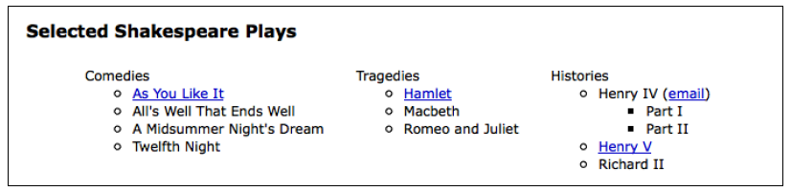
Styling list-item levels
As discussed in Chapter 1, Getting Started, we begin the jQuery code by calling $(document).ready(), which runs the function passed to it once the DOM has been loaded, but not before.
The second line uses the child combinator (>) to add the horizontal class to all the top-level items only. In effect, the selector inside the $() function is saying, "Find each list item (li) that is a child (>) of the element with an ID of selected-plays (#selected-plays)"
With the class now applied, the rules defined for that class in the stylesheet take effect, which in this case means that the list items are arranged horizontally rather than vertically. Now our nested list looks like this:

Slide 13
Styling list-item levels
Styling all the other items—those that are not in the top level—can be done in a number of ways. Since we have already applied the horizontal class to the top-level items, one way to select all sub-level items is to use a negation pseudo-class to identify all list items that do not have a class of horizontal. Note the addition of the third line of code:
$(document).readay(function() {
$('#selected-plays > li').addClass('horizontal’);
$('#selected-plays li:not(.horizontal)').addClass('sublevel’);
li:not(.horizontal)').addClass('sub-level');
});
Listing 2.2

Slide 14
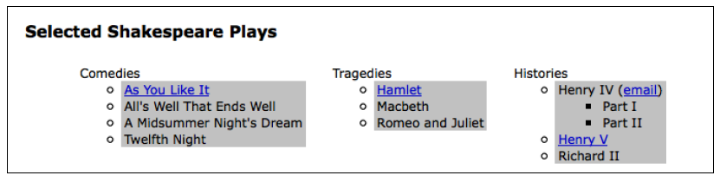
Styling list-item levels
This time we are selecting every list item (<li>) that:
Is a descendant of the element with an ID of selected-plays (#selected-plays)
Does not have a class of horizontal (:not(.horizontal))
When we add the sub-level class to these items, they receive the shaded background defined in the stylesheet:
.sub-level {
background: #ccc;
}
Now the nested list looks like this:

Slide 15
Attribute selectors
Attribute selectors are a particularly helpful subset of CSS selectors. They allow us to specify an element by one of its HTML attributes, such as a link's title attribute or an image's alt attribute. For example, to select all images that have an alt attribute, we write the following:
$('img[alt]')

Slide 16
Styling links
Attribute selectors accept a wildcard syntax inspired by regular expressions for identifying the value at the beginning (^) or end ($) of a string. They can also take an asterisk (*) to indicate the value at an arbitrary position within a string or an exclamation mark (!) to indicate a negated value.
Let's say we want to have different styles for different types of links. We first define the styles in our stylesheet:
a {
color: #00c;
}
a.mailto {
background: url(images/email.png) no-repeat right top;
padding-right: 18px;
}
a.pdflink {
background: url(images/pdf.png) no-repeat right top;
padding-right: 18px;
}
a.henrylink {
background-color: #fff;
padding: 2px;
border: 1px solid #000;
}

Slide 17
Styling links
Then, we add the three classes—mailto, pdflink, and henrylink—to the appropriate links using jQuery.
To add a class for all e-mail links, we construct a selector that looks for all anchor elements (a) with an href attribute ([href]) that begins with mailto:
(^="mailto:"), as follows:
$(document).ready(function() {
$('a[href^="mailto:"]').addClass('mailto');
});
Listing 2.3

Slide 18
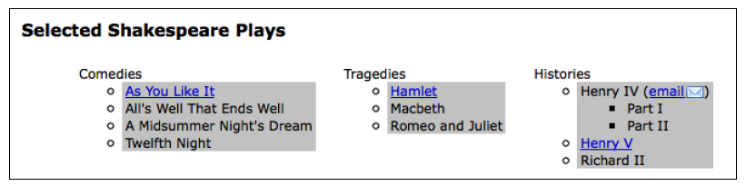
Styling links
Because of the rules defined in the page's stylesheet, an envelope image appears after the mailto: link on the page.

Slide 19
Styling links
To add a class for all the links to PDF files, we use the dollar sign rather than the caret symbol. This is because we're selecting links with an href attribute that ends with .pdf:
$(document).ready(function() {
$('a[href^="mailto:"]').addClass('mailto');
$('a[href$=".pdf"]').addClass('pdflink');
});
Listing 2.4

Slide 20
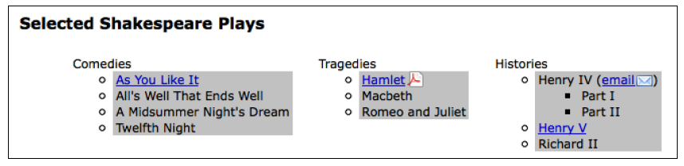
Styling links
The stylesheet rule for the newly added pdflink class causes an Adobe Acrobat icon to appear after each link to a PDF document, as shown in the following screenshot:

Slide 21
Styling links
Attribute selectors can be combined as well. We can, for example, add the class henrylink to all links with an href value that both starts with http and contains henry anywhere:
$(document).ready(function() {
$('a[href^="mailto:"]').addClass('mailto');
$('a[href$=".pdf"]').addClass('pdflink');
$('a[href^="http"][href*="henry"]').addClass('henrylink');
});
});
Listing 2.5

Slide 22
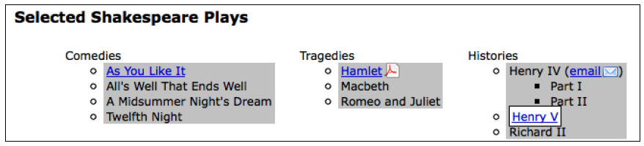
Styling links
With the three classes applied to the three types of links, we should see the following:
Note the PDF icon to the right-hand side of the Hamlet link, the envelope icon next to the email link, and the white background and black border around the Henry V link.

Slide 23
Custom selectors
To the wide variety of CSS selectors, jQuery adds its own custom selectors. These custom selectors enhance the already impressive capabilities of CSS selectors to
locate page elements in new ways.
Most of the custom selectors allow us to choose one or more elements from a collection of elements that we have already found. The custom selector syntax is the same as the CSS pseudo-class syntax, where the selector starts with a colon (:). For example, to select the second item from a set of <div> elements with a class of horizontal, we write this:
$('div.horizontal:eq(1)’)
Note that :eq(1) selects the second item in the set because JavaScript array numbering is zero-based, meaning that it starts with zero. In contrast, CSS is one-based, so a CSS selector such as $('div:nth-child(1)') would select all div selectors that are the first child of their parent. Because it can be difficult to remember which selectors are zero-based and which are one-based, we should consult the jQuery API documentation at http://api.jquery.com/category/selectors/ when in doubt.

Slide 24
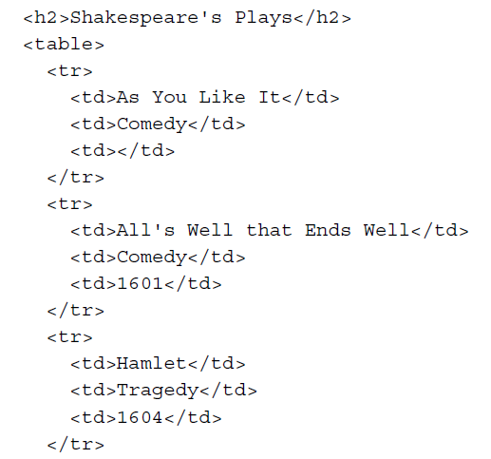
Styling alternate rows
Two very useful custom selectors in the jQuery library are :odd and :even. Let's take a look at how we can use one of them for basic table striping given the following tables:
Continues →

Slide 25
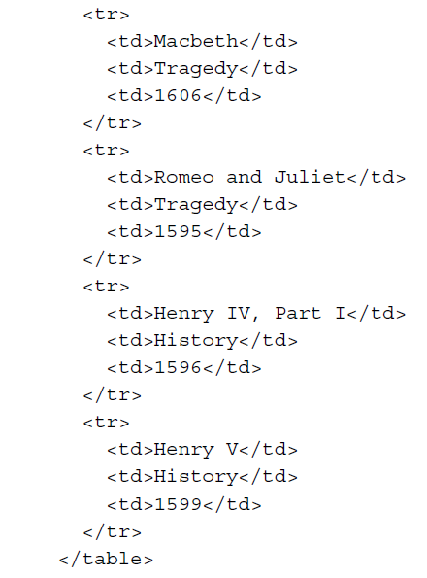
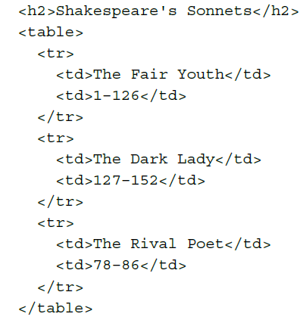
Styling alternate rows
Continues →

Slide 26
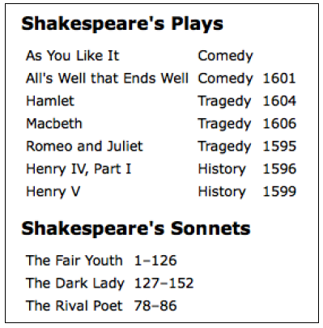
Styling alternate rows
With minimal styles applied from our stylesheet, these headings and tables appear quite plain. The table has a solid white background, with no styling separating one row from the next, as shown in the following screenshot:

Slide 27
Styling alternate rows
Now we can add a style to the stylesheet for all the table rows and use an alt class for the odd rows:
tr {
background-color: #fff;
}
.alt {
background-color: #ccc;
}
Finally, we write our jQuery code, attaching the class to the odd-numbered table
rows (<tr> tags):
$(document).ready(function() {
$('tr:even').addClass('alt');
});
Listing 2.6

Slide 28
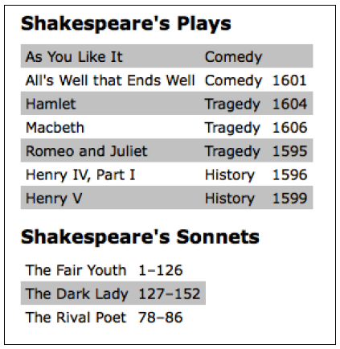
Styling alternate rows
But wait! Why use the :even selector for odd-numbered rows? Well, just as with the :eq() selector, the :even and :odd selectors use JavaScript's native zero-based numbering. Therefore, the first row counts as zero (even) and the second row counts as one (odd), and so on. With this in mind, we can expect our simple bit of code to produce tables that look like this:

Slide 29
Styling alternate rows
Note that for the second table, this result may not be what we intend. Since the last row in the Plays table has the alternate gray background, the first row in the Sonnets table has the plain white background. One way to avoid this type of problem is to use the :nth-child() selector instead, which counts an element's position relative to its parent element rather than relative to all the elements selected so far. This selector can take a number, odd, or even as its argument
$(document).ready(function() {
$('tr:nth-child(odd)').addClass('alt');
});
Listing 2.7

Slide 30
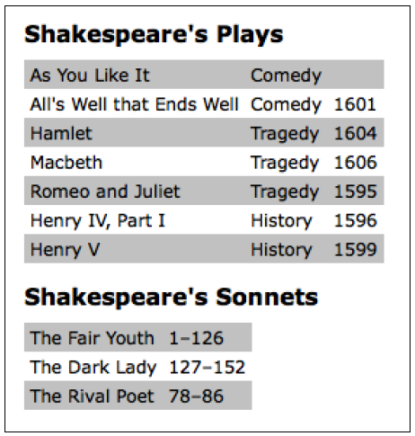
Styling alternate rows
As before, note that :nth-child() is the only jQuery selector that is one-based.
To achieve the same row striping as we did earlier—except with consistent behavior for the second table—we need to use odd rather than even as the argument. With this selector in place, both tables are now striped nicely, as shown in the following screenshot:

Slide 31
Finding elements based on textual content
For one final custom-selector touch, let's suppose for some reason we want to highlight any table cell that referred to one of the Henry plays. All we have to do—after adding a class to the stylesheet to make the text bold and italicized ( .highlight {font-weight:bold; font-style: italic;} )—is add a line to our jQuery code using the :contains() selector:
$(document).ready(function() {
$('tr:nth-child(odd)').addClass('alt');
$('td:contains(Henry)').addClass('highlight');
});
Listing 2.8

Slide 32
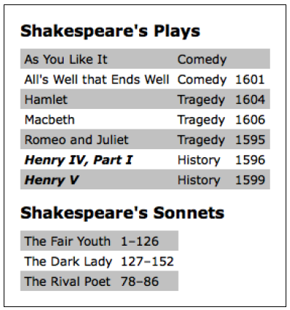
Finding elements based on textual content
So, now we can see our lovely striped table with the Henry plays prominently featured:
Admittedly, there are ways to achieve the row striping and text highlighting without jQuery—or any client-side programming, for that matter. Nevertheless, jQuery, along with CSS, is a great alternative for this type of styling in cases where the content is generated dynamically and we don't have access to either the HTML or server-side code.

Slide 33
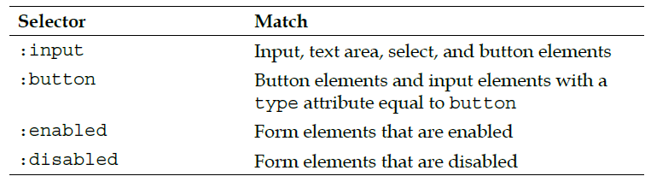
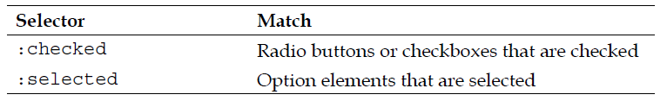
Form selectors
The capabilities of custom selectors are not limited to locating elements based on their position. For example, when working with forms, jQuery's custom selectors and complementary CSS3 selectors can make short work of selecting just the elements we need. The following table describes a handful of these form selectors:

Slide 34
Form selectors
As with the other selectors, form selectors can be combined for greater specificity. We can, for example, select all checked radio buttons (but not checkboxes) with $('input[type="radio"]:checked') or select all password inputs and disabled text inputs with $('input[type="password"], input[type="text"]:disabled').
Even with custom selectors, we can use the same basic principles of CSS to build the list of matched elements.

Slide 35
DOM traversal methods
The jQuery selectors that we have explored so far allow us to select a set of elements as we navigate across and down the DOM tree and filter the results. If this were the only way to select elements, our options would be somewhat limited. There are many occasions when selecting a parent or ancestor element is essential; that is where jQuery's DOM traversal methods come into play. With these methods at our disposal, we can go up, down, and all around the DOM tree with ease.
Some of the methods have a nearly identical counterpart among the selector expressions. For example, the line we first used to add the alt class, $('tr:even').addClass('alt'), could be rewritten with the .filter() method as follows:
$('tr').filter(':even').addClass('alt');

Slide 36
DOM traversal methods
For the most part, however, the two ways of selecting elements complement each other. Also, the .filter() method in particular has enormous power because it can take a function as its argument. The function allows us to create complex tests for whether elements should be kept in the matched set. Let's suppose, for example, we want to add a class to all external links:
a.external {
background: #fff url(images/external.png) no-repeat 100% 2px;
padding-right: 16px;
}

Slide 37
DOM traversal methods
jQuery has no selector for this sort of case. Without a filter function, we'd be forced to explicitly loop through each element, testing each one separately. With the following filter function, however, we can still rely on jQuery's implicit iteration and keep our code compact:
$('a').filter(function() {
return this.hostname && this.hostname != location.hostname;
}).addClass('external’);
Listing 2.9
The second line filters the set of <a> elements by two criteria:
They must have an href attribute with a domain name (this.hostname). We use this test to exclude mailto links, for instance.
The domain name that they link to (again, this.hostname) must not match (!=) the domain name of the current page (location.hostname).

Slide 38
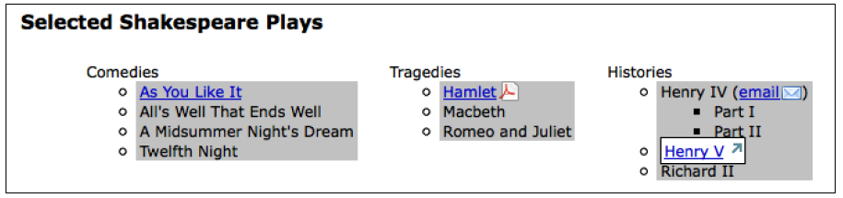
DOM traversal methods
More precisely, the .filter() method iterates through the matched set of elements, calling the function once for each and testing the return value. If the function returns false, the element is removed from the matched set. If it returns true, the element is kept.
With the .filter() method in place, the Henry V link is styled to indicate it is external:
In the next section, we'll take another look at our striped table example to see what else is possible with traversal methods.

Slide 39
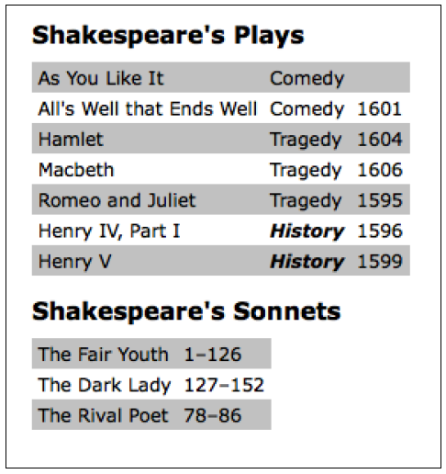
Styling specific cells
Earlier, we added a highlight class to all cells containing the text Henry. To instead style the cell next to each cell containing Henry, we can begin with the selector that we have already written and simply call the .next() method on the result:
$(document).ready(function() {
$('td:contains(Henry)').next().addClass('highlight');
});
Listing 2.10
The tables should now look like this:

Slide 40
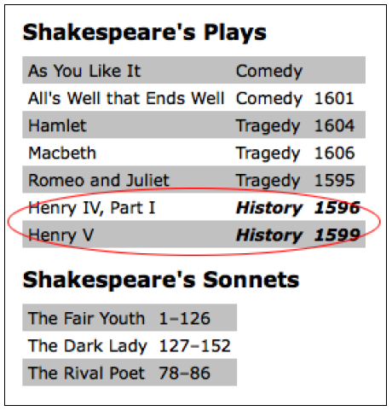
Styling specific cells
The .next() method selects only the very next sibling element. To highlight all of the cells following the one containing Henry, we could use the .nextAll()method instead:
$(document).ready(function() {
$('td:contains(Henry)').nextAll() .addClass('highlight');
});
Listing 2.11
Since the cells containing Henry are in the first column of the table, this code causes the rest of the cells in these rows to be highlighted:

Slide 41
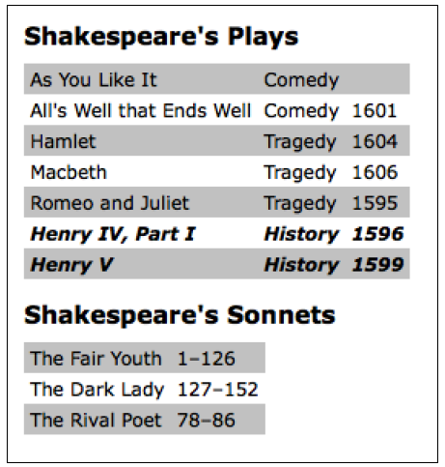
Styling specific cells
As we might expect, the .next() and .nextAll() methods have counterparts: .prev() and .prevAll(). Additionally, .siblings() selects all other elements at the same DOM level, regardless of whether they come before or after the previously selected element.
To include the original cell (the one that contains Henry) along with the cells that follow, we can add the .addBack() method:
$(document).ready(function() {
$('td:contains(Henry)').nextAll().addBack()
.addClass('highlight');
});
Listing 2.12
With this modification in place, all of the cells in the row get the styling offered by the highlight class:

Slide 42
Styling specific cells
There are a multitude of selector and traversal-method combinations by which we can select the same set of elements. Here, for example, is another way to select every cell in each row where at least one of the cells contains Henry:
$(document).ready(function() {
$('td:contains(Henry)').parent().children().addClass('highlight');
});
Listing 2.13
Rather than traversing across to sibling elements, we travel up one level in the DOM to the <tr> tag with .parent() and then select all of the row's cells with .children().

Slide 43
Chaining
The traversal method combinations that we have just explored illustrate jQuery’s chaining capability. With jQuery, it is possible to select multiple sets of elements and do multiple things with them, all within a single line of code. This chaining not only helps keep jQuery code concise, but it also can improve a script's performance when the alternative is to respecify a selector.
It is also possible to break a single line of code into multiple lines for greater readability. For example, a single chained sequence of methods could be written in one line:
$('td:contains(Henry)').parent().find('td:eq(1)’).addClass('highlight').end()
.find('td:eq(2)').addClass('highlight’);
Listing 2.14

Slide 44
Chaining
This same sequence of methods could also be written in seven lines:
$('td:contains(Henry)') // Find every cell containing "Henry"
.parent() // Select its parent
.find('td:eq(1)') // Find the 2nd descendant cell
.addClass('highlight') // Add the "highlight" class
.end() // Return to the parent of the cell containing "Henry"
.find('td:eq(2)') // Find the 3rd descendant cell
.addClass('highlight'); // Add the "highlight" class
Listing 2.15
The DOM traversal in this example is contrived and not recommended. There are clearly simpler, more direct methods at our disposal. The point of the example is simply to demonstrate the tremendous flexibility that chaining affords us. Chaining can be like speaking a whole paragraph's worth of words in a single breath—it gets the job done quickly, but it can be hard for someone else to understand. Breaking it up into multiple lines and adding judicious comments can save more time in the long run.

Slide 45
Accessing DOM elements
Every selector expression and most jQuery methods return a jQuery object. This is almost always what we want because of the implicit iteration and chaining capabilities that it affords.
Still, there may be points in our code when we need to access a DOM element directly. For example, we may need to make a resulting set of elements available to another JavaScript library, or we might need to access an element's tag name, which is available as a property of the DOM element. For these admittedly rare situations, jQuery provides the .get() method. To access the first DOM element referred to by a jQuery object, for example, we would use .get(0). So, if we want to know the tag name of an element with an ID of my-element, we would write:
varmyTag = $('#my-element').get(0).tagName;

Slide 46
Accessing DOM elements
For even greater convenience, jQuery provides a shorthand for .get(). Instead of writing the previous line, we can use square brackets immediately following the selector:
varmyTag = $('#my-element')[0].tagName;
It's no accident that this syntax appears to treat the jQuery object as an array of DOM elements; using the square brackets is like peeling away the jQuery layer to get at the node list, and including the index (in this case, 0) is like plucking out the DOM element itself.

Slide 47
Summary
With the techniques that we have covered in this chapter, we should now be able to locate sets of elements on the page in a variety of ways. In particular, we learned how to style top-level and sub-level items in a nested list by using basic CSS selectors, how to apply different styles to different types of links by using attribute selectors, add rudimentary striping to a table by using either the custom jQuery selectors :odd and :even or the advanced CSS selector :nth-child(), and highlight text within certain table cells by chaining jQuery methods.
So far, we have been using the $(document).ready() method to add a class to a matched set of elements. In the next chapter, we'll explore ways in which to add a class in response to a variety of user-initiated events.

